Slide 1
Unsupervised Learning: k-means

Slide 2
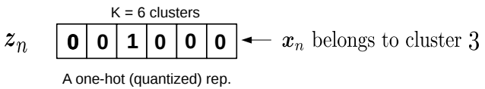
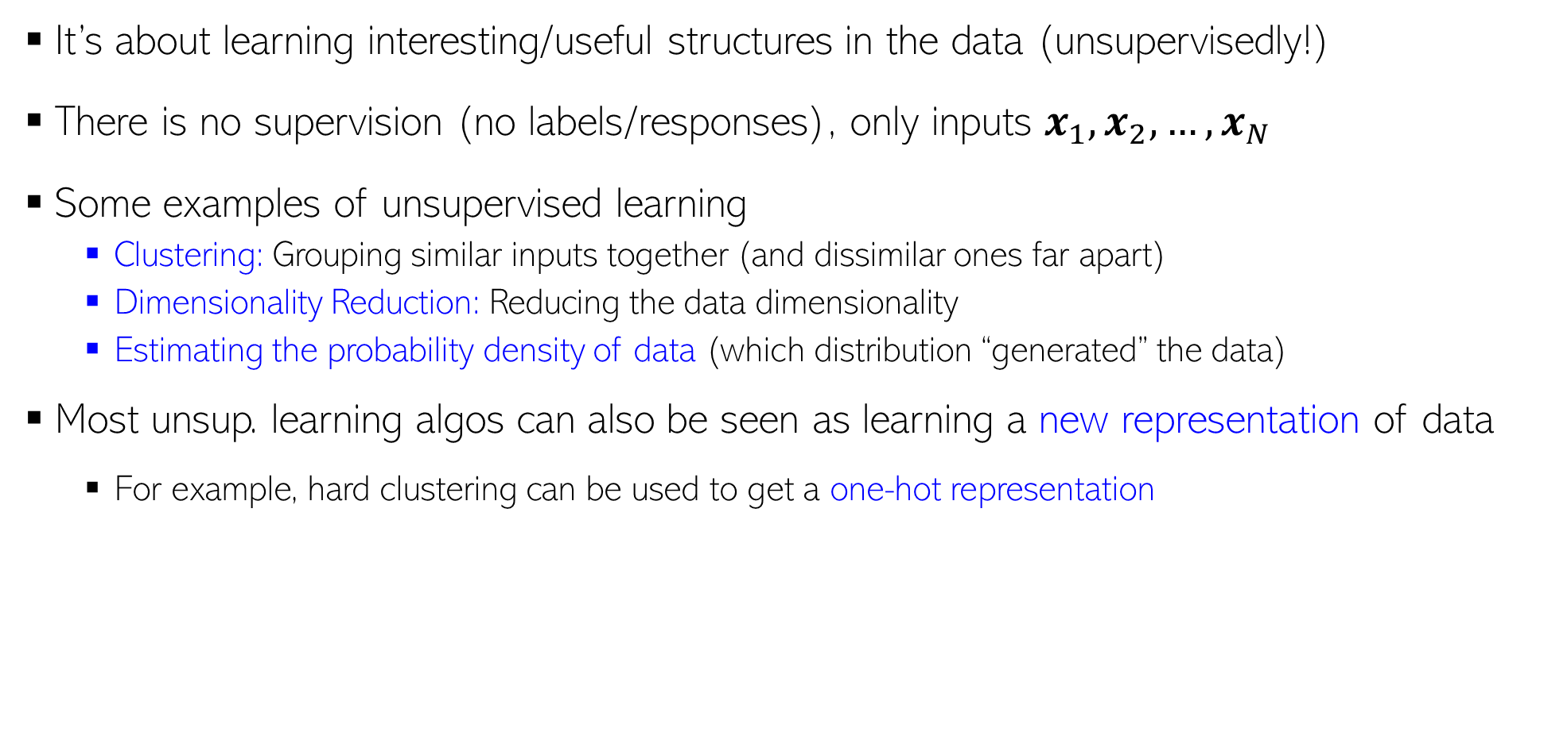
Unsupervised Learning
It’s about learning interesting/useful structures in the data (unsupervisedly!)
There is no supervision (no labels/responses), only inputs $x_{1},x_{2},…, x_{N}$
Some examples of unsupervised learning
Clustering: Grouping similar inputs together (and dissimilar ones far apart)
Dimensionality Reduction: Reducing the data dimensionality
Estimating the probability density of data (which distribution “generated” the data)
Most unsup. learning algos can also be seen as learning a new representation of data
For example, hard clustering can be used to get a one-hot representation
Each point belongs deterministically to a single cluster

Slide 3
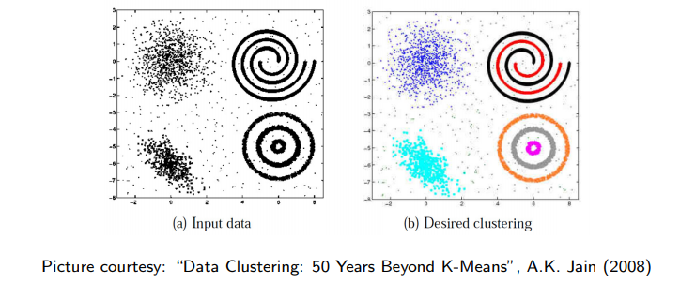
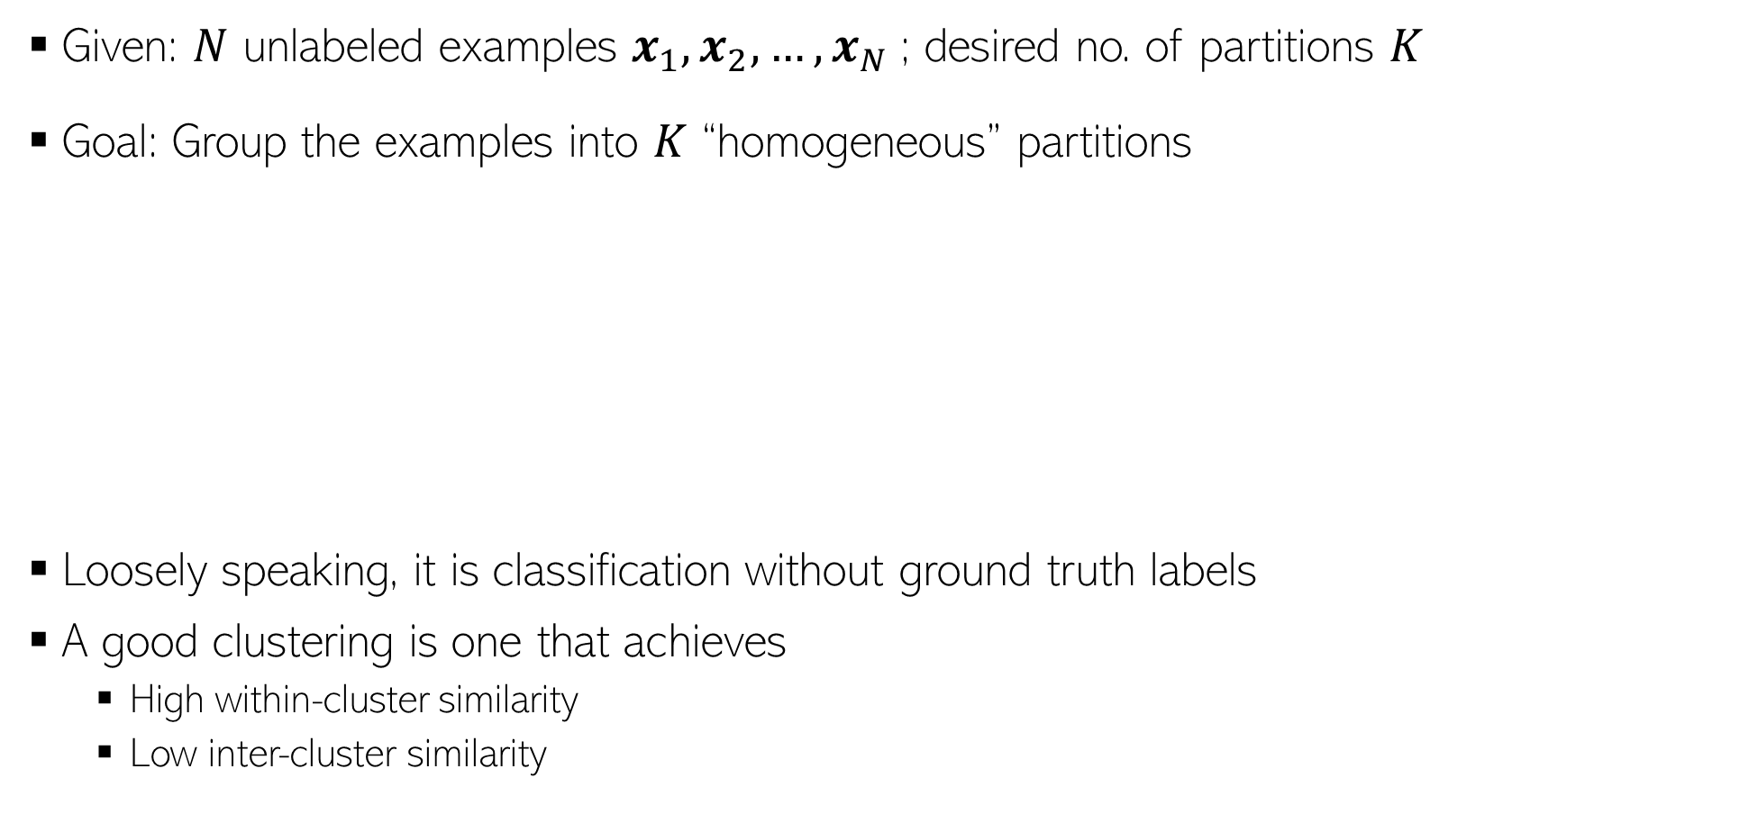
Clustering
In some cases, we may not know the right number of clusters in the data and may want to learn that (technique exists for doing this but beyond the scope)
Given: $N$ unlabeled examples $x_{1},x_{2},…, x_{N}$; desired no. of partitions $K$
Goal: Group the examples into $K$ “homogeneous” partitions
Loosely speaking, it is classification without ground truth labels
A good clustering is one that achieves
High within-cluster similarity
Low inter-cluster similarity

Slide 4
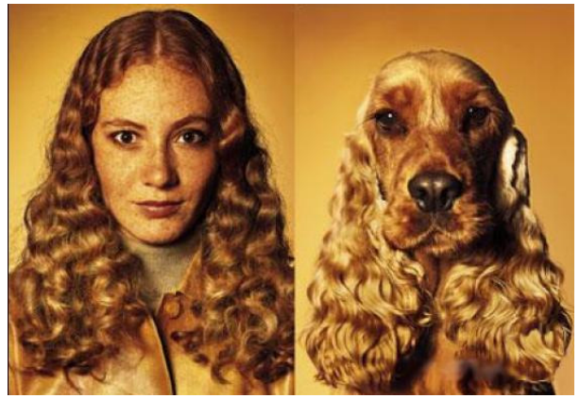
Similarity can be Subjective
Clustering only looks at similarities b/w inputs, since no labels are given
Without labels, similarity can be hard to define
Thus using the right distance/similarity is very important in clustering
In some sense, related to asking: “Clustering based on what”?
Picture courtesy: http://www.guy-sports.com/humor/videos/powerpoint presentation dogs.htm

Slide 5
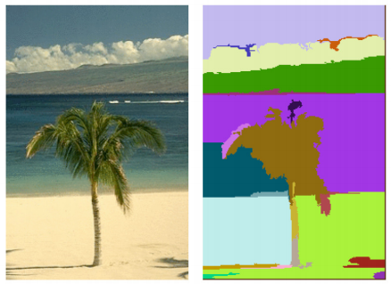
Clustering: Some Examples
Document/Image/Webpage Clustering
Image Segmentation (clustering pixels)
Clustering web-search results
Clustering (people) nodes in (social) networks/graphs
.. and many more..
Picture courtesy: http://people.cs.uchicago.edu/∼pff/segment/

Slide 6
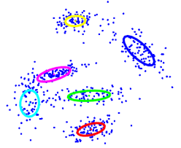
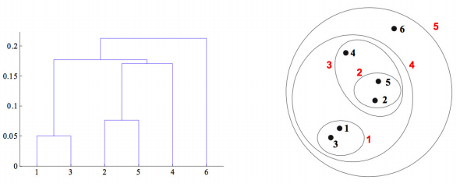
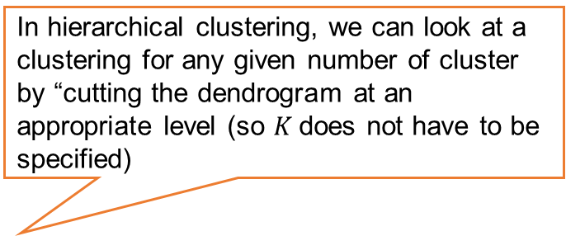
Types of Clustering
Flat or Partitional clustering
Partitions are independent of each other
Hierarchical clustering
Partitions can be visualized using a tree structure (a dendrogram)
In hierarchical clustering, we can look at a clustering for any given number of cluster by “cutting the dendrogram at an appropriate level (so $K$does not have to be specified)
Hierarchical clustering gives us a clustering at multiple levels of granularity

Slide 7
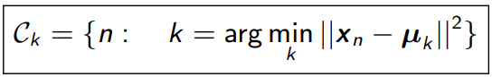

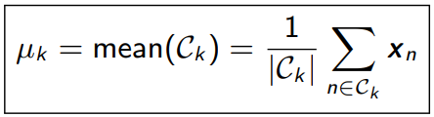
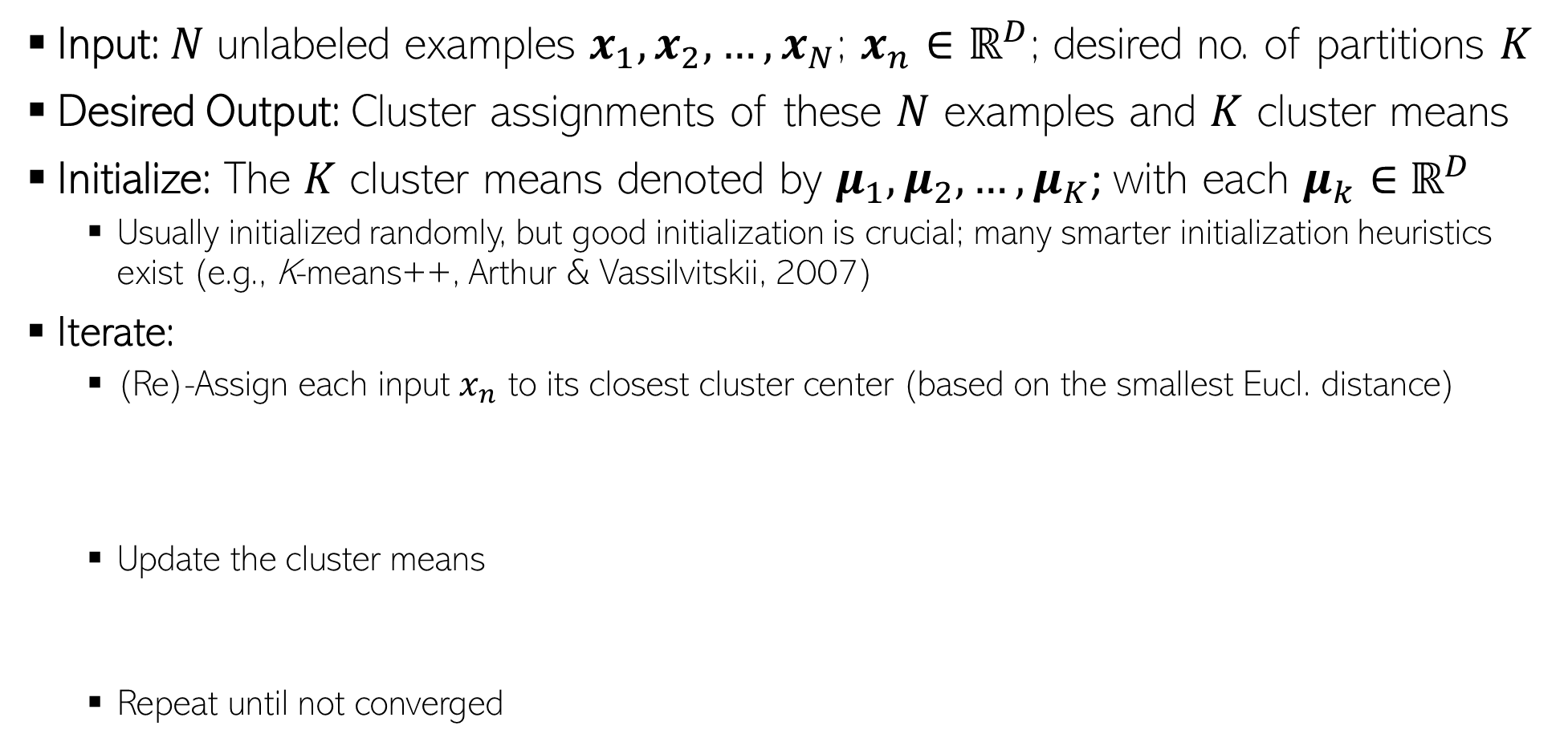
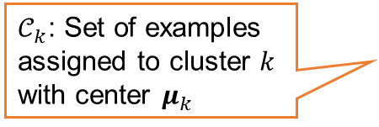
Flat Clustering: K-means algorithm (Lloyd, 1957)
Input: $N$ unlabeled examples $x_{1},x_{2},…, x_{N}$; $x_{n}∈ℝ^{D}$; desired no. of partitions $K$
Desired Output: Cluster assignments of these $N$ examples and $K$ cluster means
Initialize: The $K$ cluster means denoted by $μ_{1},μ_{2},…, μ_{K}$; with each $μ_{k}∈$ $ℝ^{D}$
Usually initialized randomly, but good initialization is crucial; many smarter initialization heuristics exist (e.g., K-means++, Arthur & Vassilvitskii, 2007)
Iterate:
(Re)-Assign each input $x_{n}$ to its closest cluster center (based on the smallest Eucl. distance)
Update the cluster means
Repeat until not converged
Some ways to declare convergence if between two successive iterations:
Cluster means don’t change
Cluster assignments don’t change
Clustering “loss” doesn’t change by much
$𝒞_{k}$: Set of examples assigned to cluster $k$ with center $μ_{k}$

Slide 8
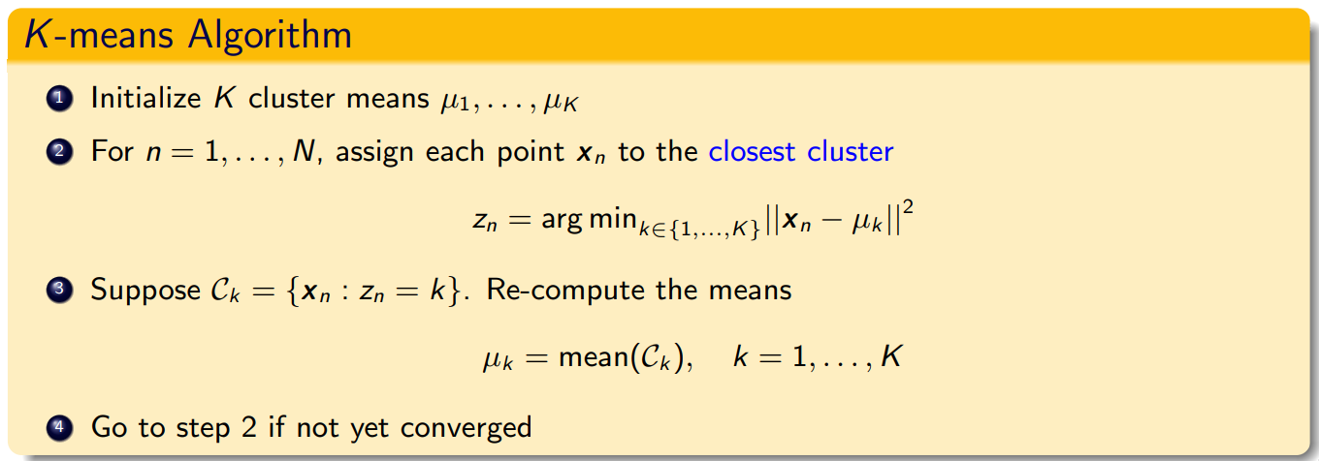
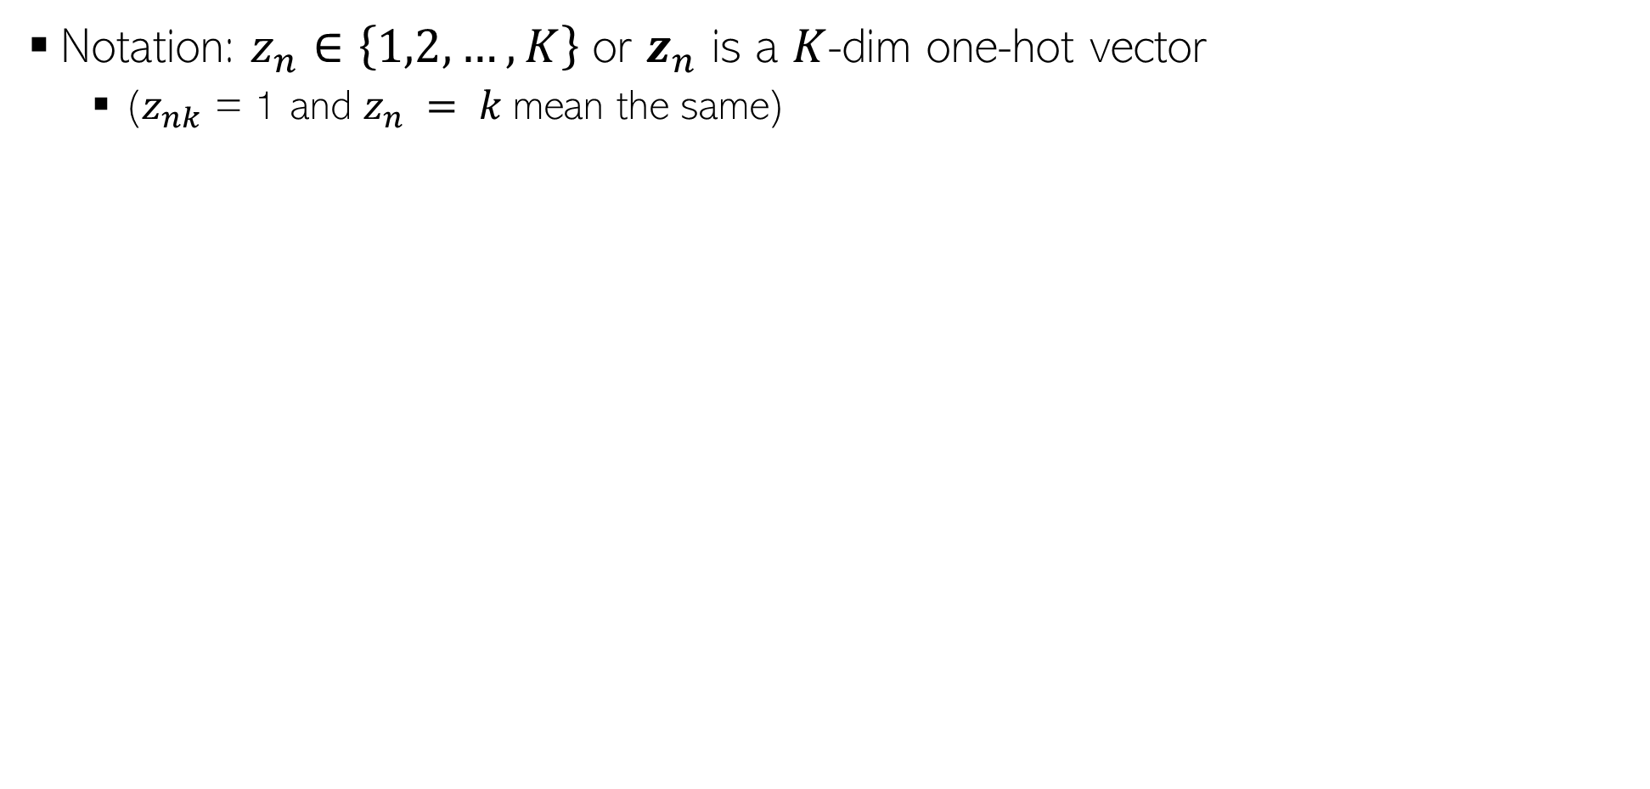
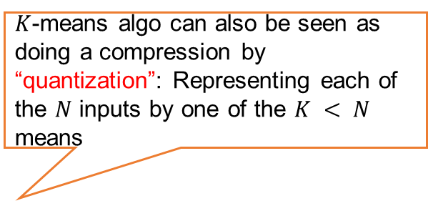
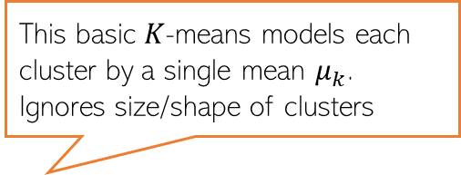
K-means algorithm: Summarized Another Way
Notation: $z_{n}∈\left\{1,2,…, K\right\}$ or $z_{n}$ is a $K$-dim one-hot vector
($z_{nk}$ = 1 and $z_{n} = k$mean the same)
$K$-means algo can also be seen as doing a compression by “quantization”: Representing each of the $N$ inputs by one of the $K < N$ means
This basic $K$-means models each cluster by a single mean $μ_{k}$. Ignores size/shape of clusters

Slide 9
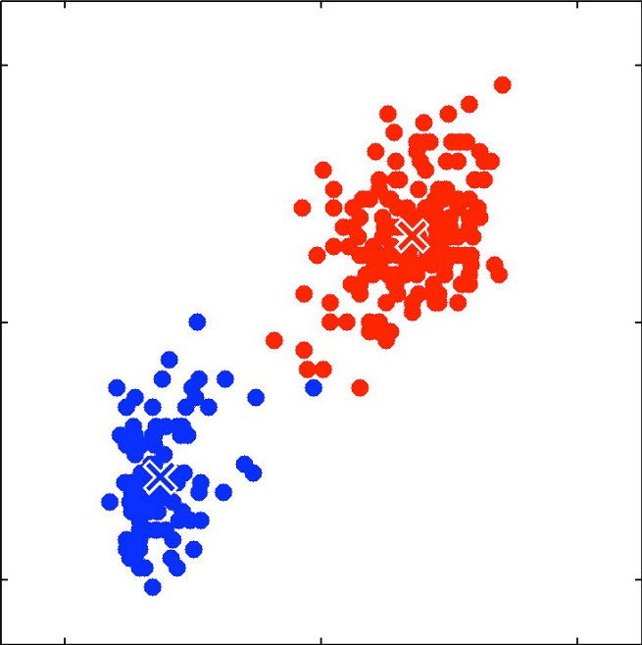
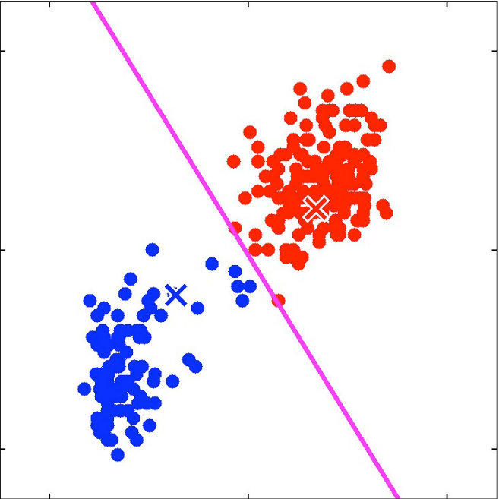
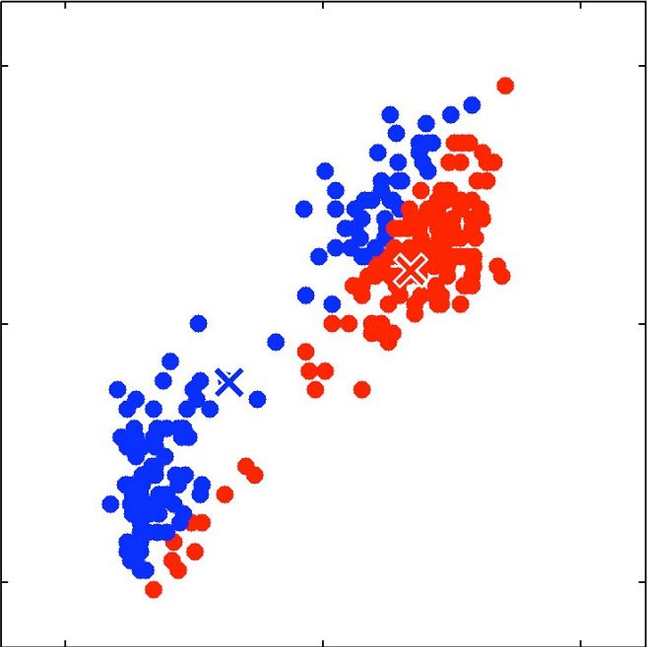

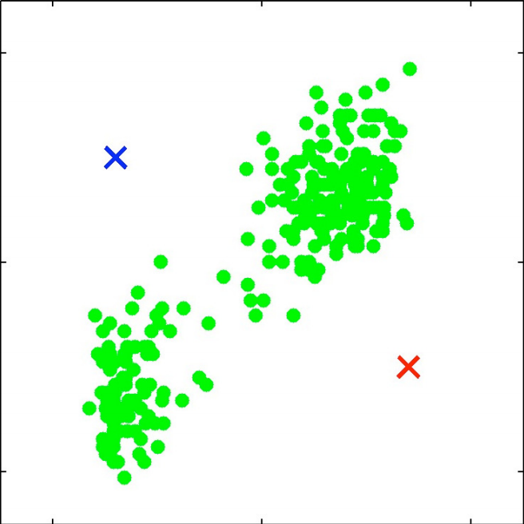
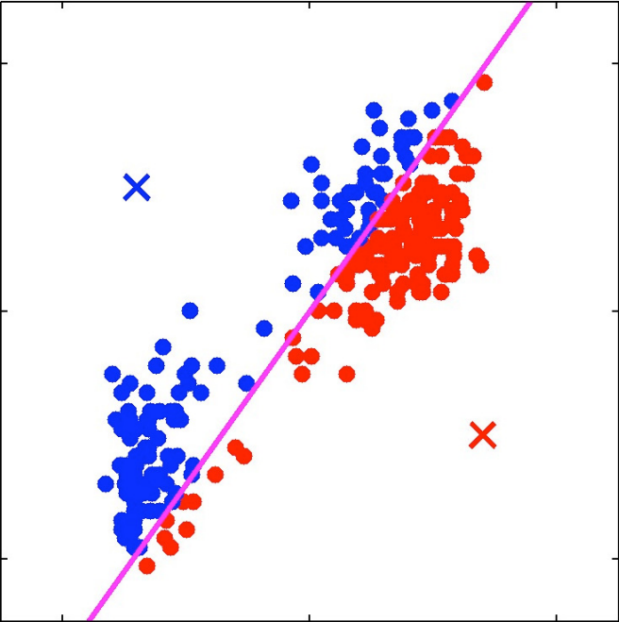
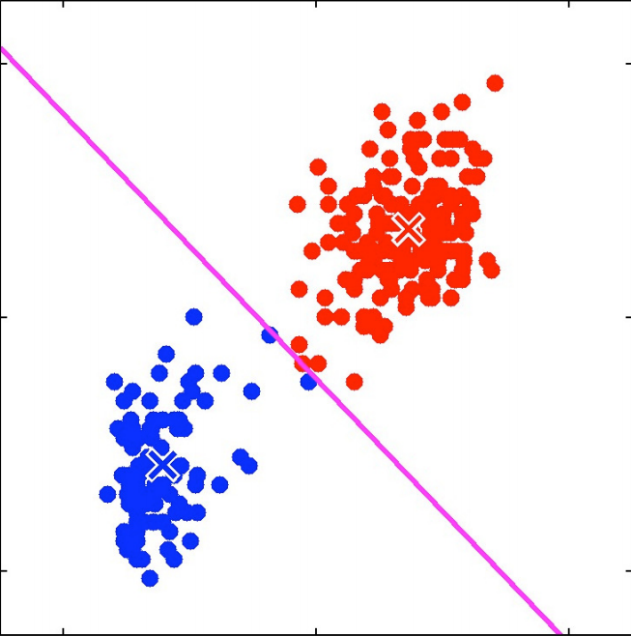
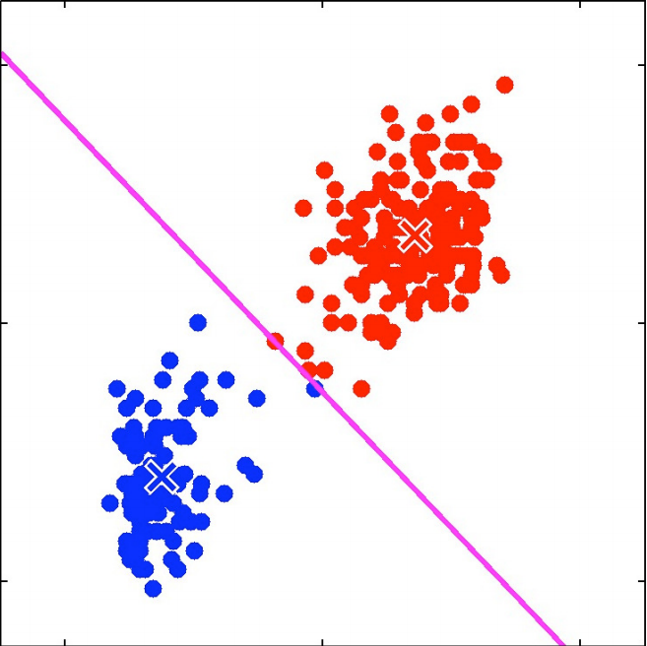

K-means: An Illustration

Slide 10
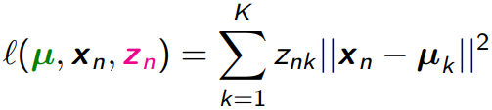
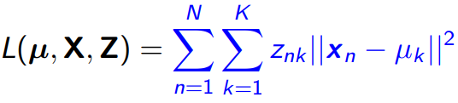
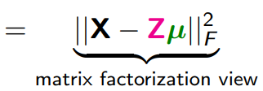

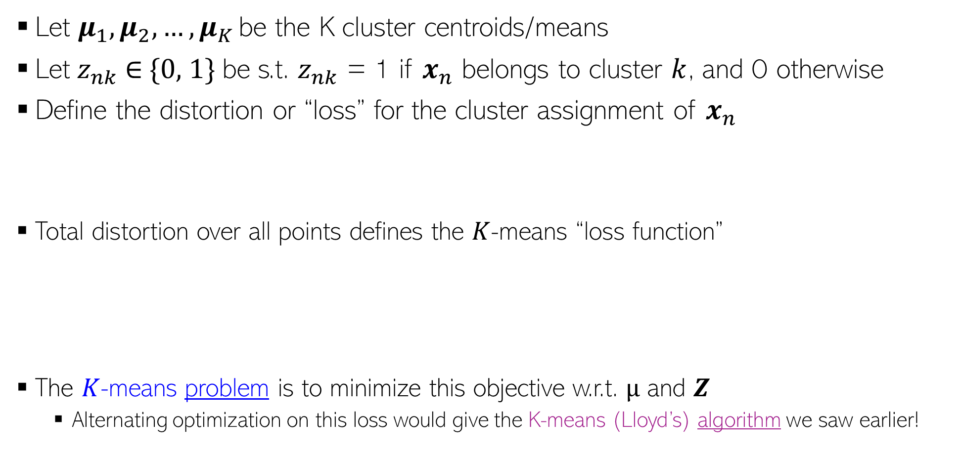
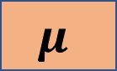
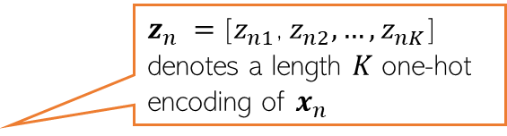
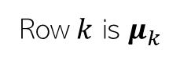
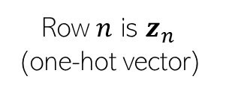
What Loss Function is K-means Optimizing?
$z_{n} =$[$z_{n1}$, $z_{n2}, …, z_{nK}$] denotes a length $K$ one-hot encoding of $x_{n}$
Let $μ_{1},μ_{2},…, μ_{K}$ be the K cluster centroids/means
Let $z_{nk}$ ∈ {0, 1} be s.t. $z_{nk}$ = 1 if $x_{n}$ belongs to cluster $k$, and 0 otherwise
Define the distortion or “loss” for the cluster assignment of $x_{n}$
Total distortion over all points defines the $K$-means “loss function”
The $K$-means problem is to minimize this objective w.r.t. $µ$ and $Z$
Alternating optimization on this loss would give the K-means (Lloyd’s) algorithm we saw earlier!
K
K
X
Z
K
$$μ$$
N
$$≈$$
Row $k$ is $μ_{k}$
Row $n$ is $z_{n}$ (one-hot vector)

Slide 11
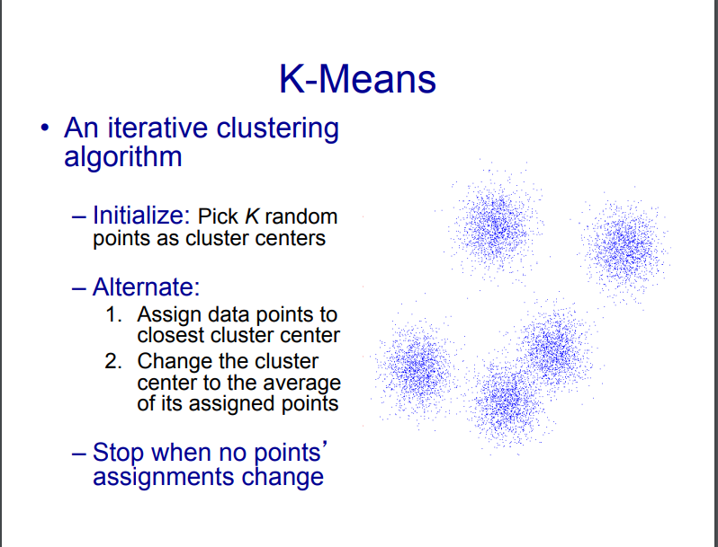

Slide 12
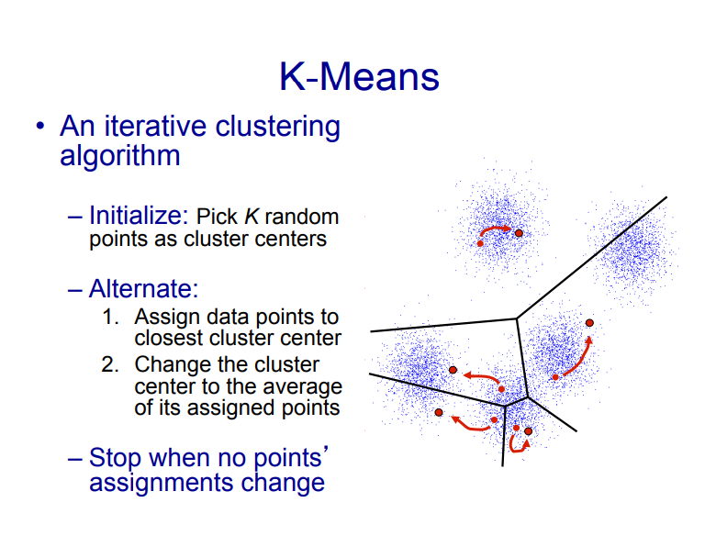

Slide 13
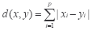
Common Distance measures:
Distance measure will determine how the similarity of two elements is calculated and it will influence the shape of the clusters.
They include:
1. The Euclidean distance (also called 2-norm distance) is given by:
2. The Manhattan distance (also called taxicab norm or 1-norm) is given by:

Slide 14
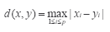
3.The maximum norm is given by:
4. The Mahalanobis distance corrects data for different scales and correlations in the variables.
5. Inner product space: The angle between two vectors can be used as a distance measure when clustering high dimensional data
6. Hamming distance (sometimes edit distance) measures the minimum number of substitutions required to change one member into another.

Slide 15
K-MEANS CLUSTERING
The k-means algorithm is an algorithm to cluster n objects based on attributes into k partitions, where k < n.
It assumes that the object attributes form a vector space.

Slide 16
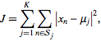
K-MEANS CLUSTERING
An algorithm for partitioning (or clustering) N data points into K disjoint subsets S_{j} containing data points so as to minimize the sum-of-squares criterion
where x_{n} is a vector representing the the n^{th} data point and u_{j} is the geometric centroid of the data points in S_{j}.

Slide 17
K-MEANS CLUSTERING
Simply speaking k-means clustering is an algorithm to classify or to group the objects based on attributes/features into K number of group.
K is positive integer number.
The grouping is done by minimizing the sum of squares of distances between data and the corresponding cluster centroid.

Slide 18
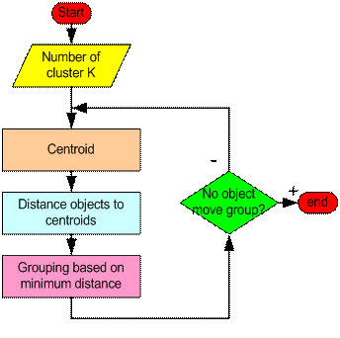
How the K-Mean Clustering algorithm works?

Slide 19
K-means: Choosing K
There is a popular method known as elbow method which is used to determine the optimal value of K to perform the K-Means Clustering Algorithm.
The basic idea behind this method is that it plots the various values of error/cost with changing k.
As the value of K increases, there will be fewer elements in the cluster. So average distortion will decrease.
The lesser number of elements means closer to the centroid. So, the point where this distortion declines the most is the elbow point.

Slide 20
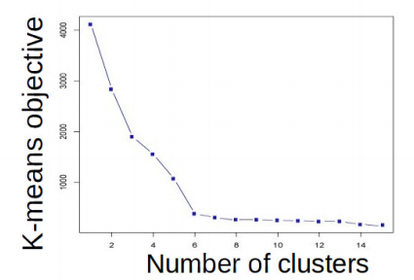
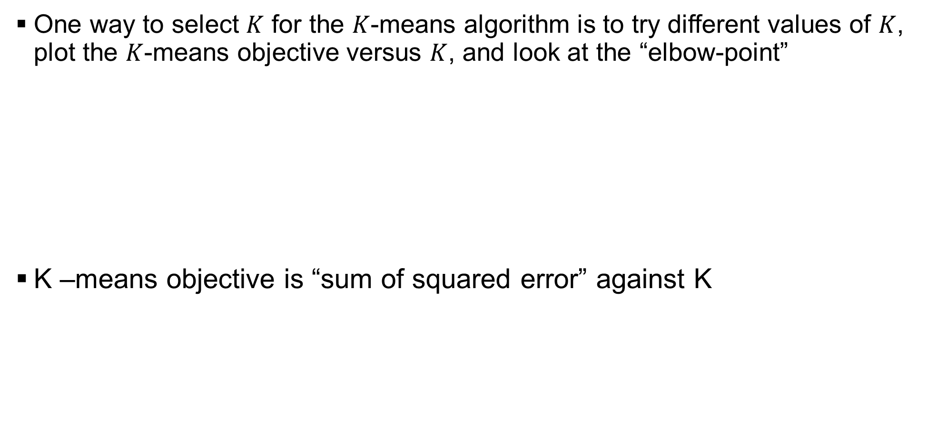
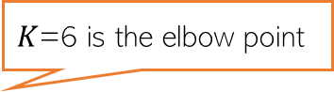
K-means: Choosing K
One way to select $K$ for the $K$-means algorithm is to try different values of $K$, plot the $K$-means objective versus $K$, and look at the “elbow-point”
K –means objective is “sum of squared error” against K
$K$=6 is the elbow point

Slide 21
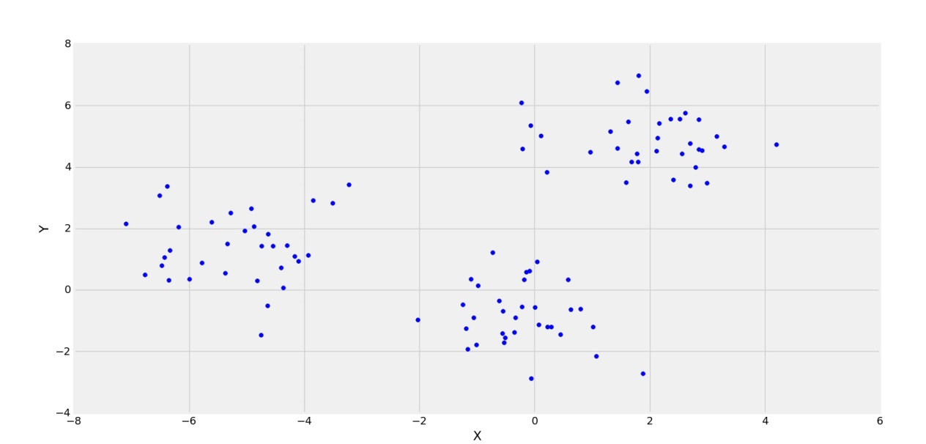
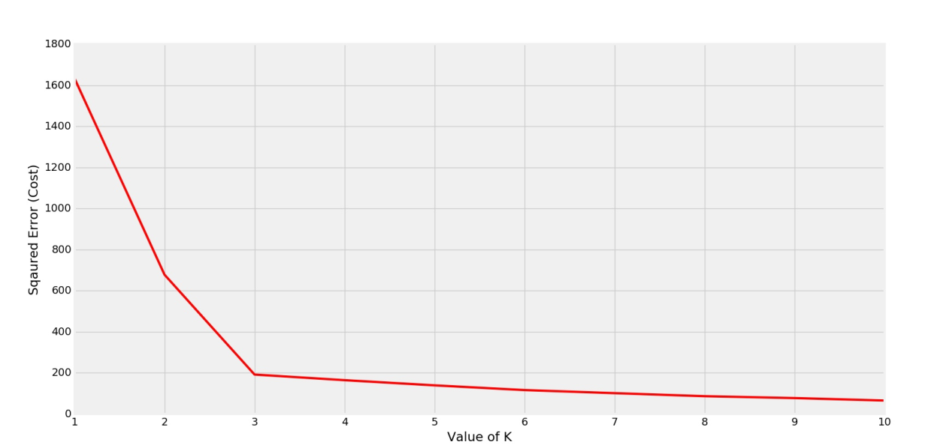
K-means: Choosing K

Slide 22
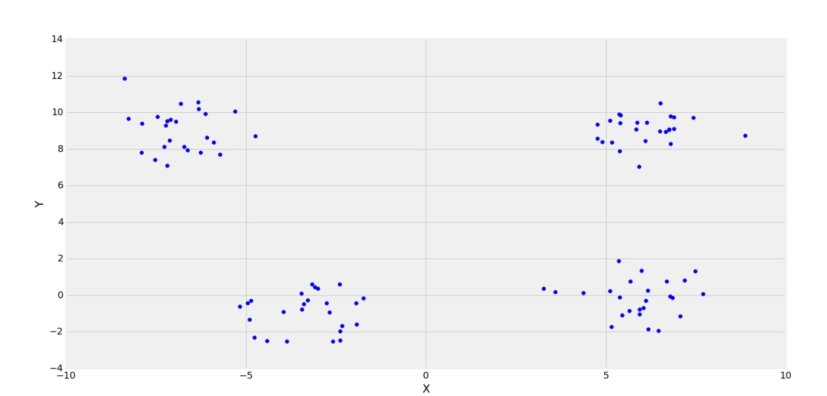
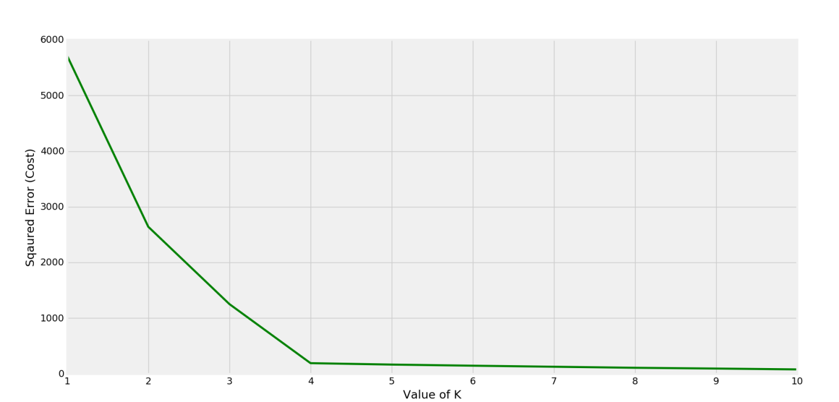
K-means: Choosing K

Slide 23
Thank you

